Slide 1
Naive Bayesian Networks
Dr.Muhammad.Shahbaz@gmail.com
© M. Shahbaz –

Slide 2
Lecture Outline
Introduction to Bayesian methods for classification.
Statistical technique, based on estimates of probabilities.
Probabilities and conditional probabilities.
Bayes theorem.
The Naive Bayes classifier method
Example of Bayes classification

Slide 3
Bayesian Classifiers
Bayesian classifiers use Bayes probability for classification
We can say Bayesian classification is a statistical technique, based on estimates of probabilities to predict class membership of sample data
Bayesian & Classical Probability…?

Slide 4
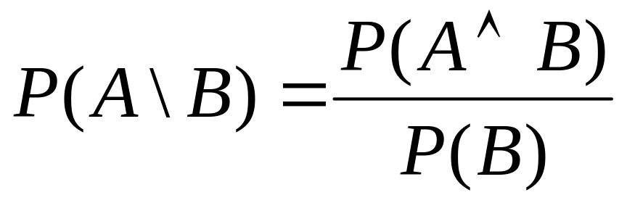
Probability & Conditional Probability
A and B are events (things that may or may not occur).
P(A) is the probability that event A occurs.
P(A\B) is the probability that event A occurs, given that we know event B has occurred.
Definition,
So, P(A ∧ B) = P(A\B)P(B) = P(B\A)P(A)

Slide 5
Bayes Theorum
Let X be the data sample whose class label is unknown
Let H be the hypothesis that X belongs to class C
Objective is to determine P(H\X) i.e. the probability H holds given the observed data sample X

Slide 6
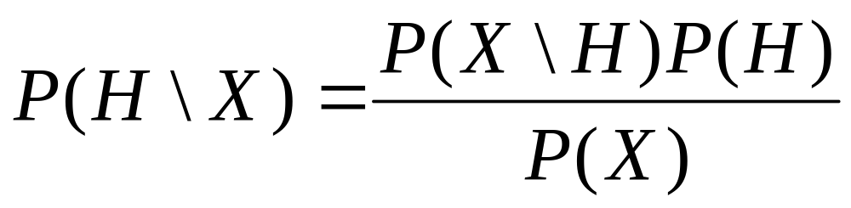
Bayes Theorum
P(H\X) is the posterior (posteriori) probability of H conditioned on X
Let H be a hypothesis, e.g. a statement of which class C a data sample X belongs to,
Where
P(H) is the prior (priori) probability of the hypothesis
This probability is independent of X

Slide 7
Bayes Theorem
P(X), the prior probability of the data sample regardless of whether H is true or not.
P(X\H) gives the posterior (a posteriori) probability of observing X if H is true.
P(H\X) gives the posterior probability of H being true given that data sample X is observed

Slide 8
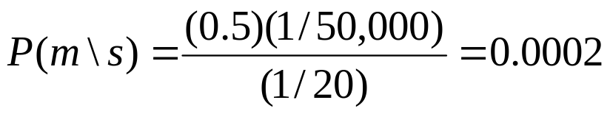
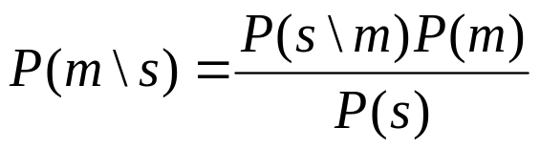
Bayes Rule Example
Example from medical diagnosis,
s  patient has a stiff neck
m  patient has meningitis.
A patient with meningitis will have a stiff neck 50% of the time.
If prior probability of a patient having meningitis is 1/50,000, and prior probability of a stiff neck is 1/20,
P(s\m) = 0.5
P(m) = 1/50,000
P(s) = 1/20
Probability of meningitis in patients having stiff neck

Slide 9
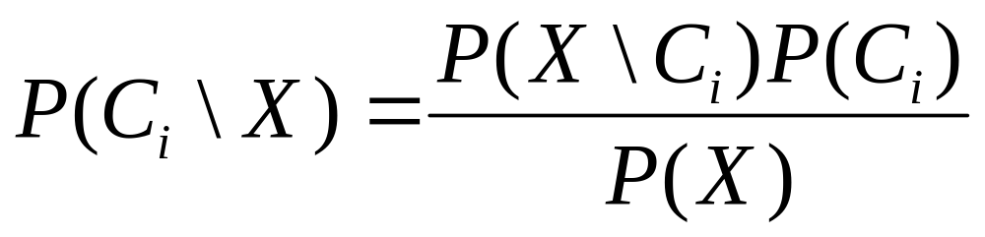
Naive Bayesian Classification
Each example is given by input attribute vector
X = {x₁ x₂, . . . , x_{n}} in n dimensions, based on attributes A₁,A₂, . . . ,A_{n}
Output classes are C₁, . . . ,C_{m}
If we don’t know the class for a given X, guess the class with the highest posterior probability, conditioned on X.
We use Bayes rule,
Now, P(X) is constant across all classes for a particular example X, so we just maximise P(X\C_{i})P(C_{i}).
If we don’t know the priori class probabilities, we often
assume that P(C₁) = P(C₂) = … = P(C_{m})
For maximising left hand side we need to maximise right hand side

Slide 10
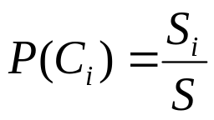
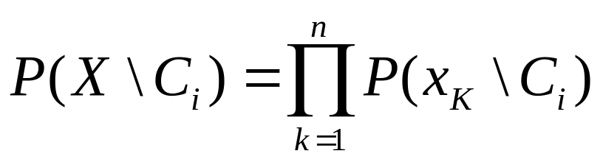
Class Conditional Independence
The class prior probabilities are usually estimated by
where s_{i} is number of training examples of class C_{i} and s is the total number of training examples.
Note that,
P(X\C_{i}) = P((A₁ = x₁) ∧ (A₂ = x₂) ∧… ∧ (A_{n} = x_{n})\C_{i}).
It could be very costly to evaluate this quantity, in the general case.
Naive Bayes makes the assumption that the values of attributes are conditionally independent of one another
(class conditional independence assumption => Naive). So,

Slide 11
Training Dataset for Example
RID | age | income | student | credit-rating | Class: Buys Computer
1 | <=30 | high | no | fair | no
2 | <=30 | high | no | excellent | no
3 | 31-40 | high | no | fair | yes
4 | >40 | medium | no | fair | yes
5 | >40 | low | yes | fair | yes
6 | >40 | low | yes | excellent | no
7 | 31-40 | low | yes | excellent | yes
8 | <=30 | medium | no | fair | no
9 | <=30 | low | yes | fair | yes
10 | >40 | medium | yes | fair | yes
11 | <=30 | medium | yes | excellent | yes
12 | 31-40 | medium | no | excellent | yes
13 | 31-40 | high | yes | fair | yes
14 | >40 | medium | no | excellent | no
Dr.Muhammad.Shahbaz@gmail.com
© M. Shahbaz –

Slide 12
Example
Let,
C₁  “buys-computer=yes”,
C₂  “buys-computer=no”
Suppose X=(age=“<=30”, income=“medium”, Student=“yes”, credit-rating=“fair”).
We should maximise P(X\C_{i})P(C_{i}), over i = 1, 2
Compute prior probabilities of classes,
P(buys-computer=“yes”)= 9/14 = 0.643
P(buys-computer=“no”) = 5/14 = 0.357
Dr.Muhammad.Shahbaz@gmail.com
© M. Shahbaz –

Slide 13
Example
Working out the conditional probabilities,
P(age=”<=30”|buys-computer=”yes”) = 2/9 = 0.222
P(age=”<=30”|buys-computer=”no”) = 3/5 = 0.600
P(income=”medium”|buys-computer=”yes”) = 4/9=0.444
P(income=”medium”|buys-computer=”no”) = 2/5=0.400
P(student=”yes”|buys-computer=”yes”) = 6/9=0.667
P(student=”yes”|buys-computer=”no”) = 1/5 = 0.200
P(credit-rating=”fair”|buys-computer=”yes”) = 6/9=0.667
P(credit-rating=”fair”|buys-computer=”no”) = 2/5 = 0.400
Dr.Muhammad.Shahbaz@gmail.com
© M. Shahbaz –

Slide 14
Example
Now,
P(X|buys-computer=”yes”) = 0.222 * 0.444 * 0.667 *
0.667 = 0.044
P(X|buys-computer=”no”) = 0.600 * 0.400 * 0.200 *
0.400 = 0.019
P(X|buys-computer=”yes”)P(buys-computer=”yes”) =
0.044 * 0.643 = 0.028
P(X|buys-computer=”no”)P(buys-computer=”no”) =
0.019 * 0.357 = 0.007
Therefore, classifier predicts buys-computer=”yes” for
this sample X.
Dr.Muhammad.Shahbaz@gmail.com
© M. Shahbaz –

Slide 15
Performance of Bayesian Methods
In theory, they should have the minimum error rate of all
classification methods.
In practice, there may be problems with,
Inaccuracies in assumptions made (e.g. class
conditional independence).
Non-Availability of data for probability estimates.
Often have comparable performance to neural nets and
decision trees.
Dr.Muhammad.Shahbaz@gmail.com
© M. Shahbaz –

Slide 16
Conclusion
We have introduced Naive Bayes as a method for classification.
This method relies on the assumption of class conditional independence.
If this assumption is not true, we need Bayesian
Belief Networks, which are more complicated than
Naive Bayes – use full joint conditional probability
distributions.
Dr.Muhammad.Shahbaz@gmail.com
© M. Shahbaz –

Slide 17
Questions
?

